Slide 1
SmartPass
Network Security Design Challenge
Smartphone MFA password manager
Jay Lohokare
111492930

Slide 2

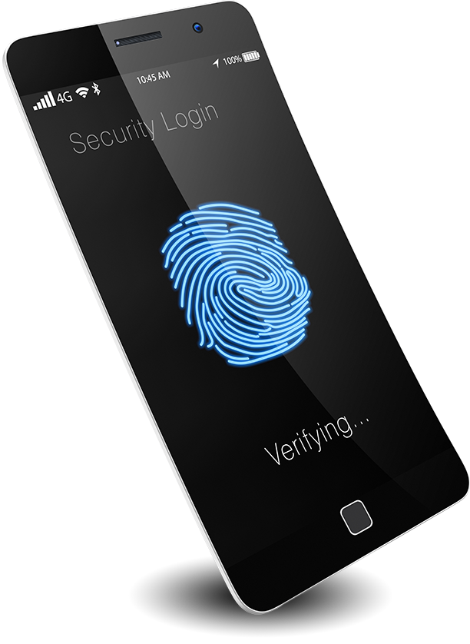


Targeted features (Motivation)
Ease of use
Secure,
Biometrics
Share access
Portability

Slide 3
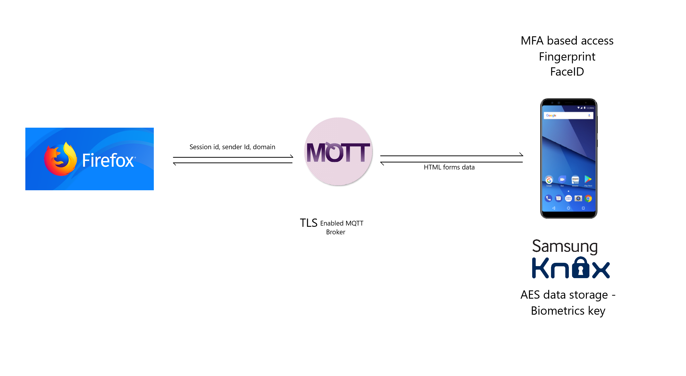

Slide 4
Firefox plugin

Slide 5
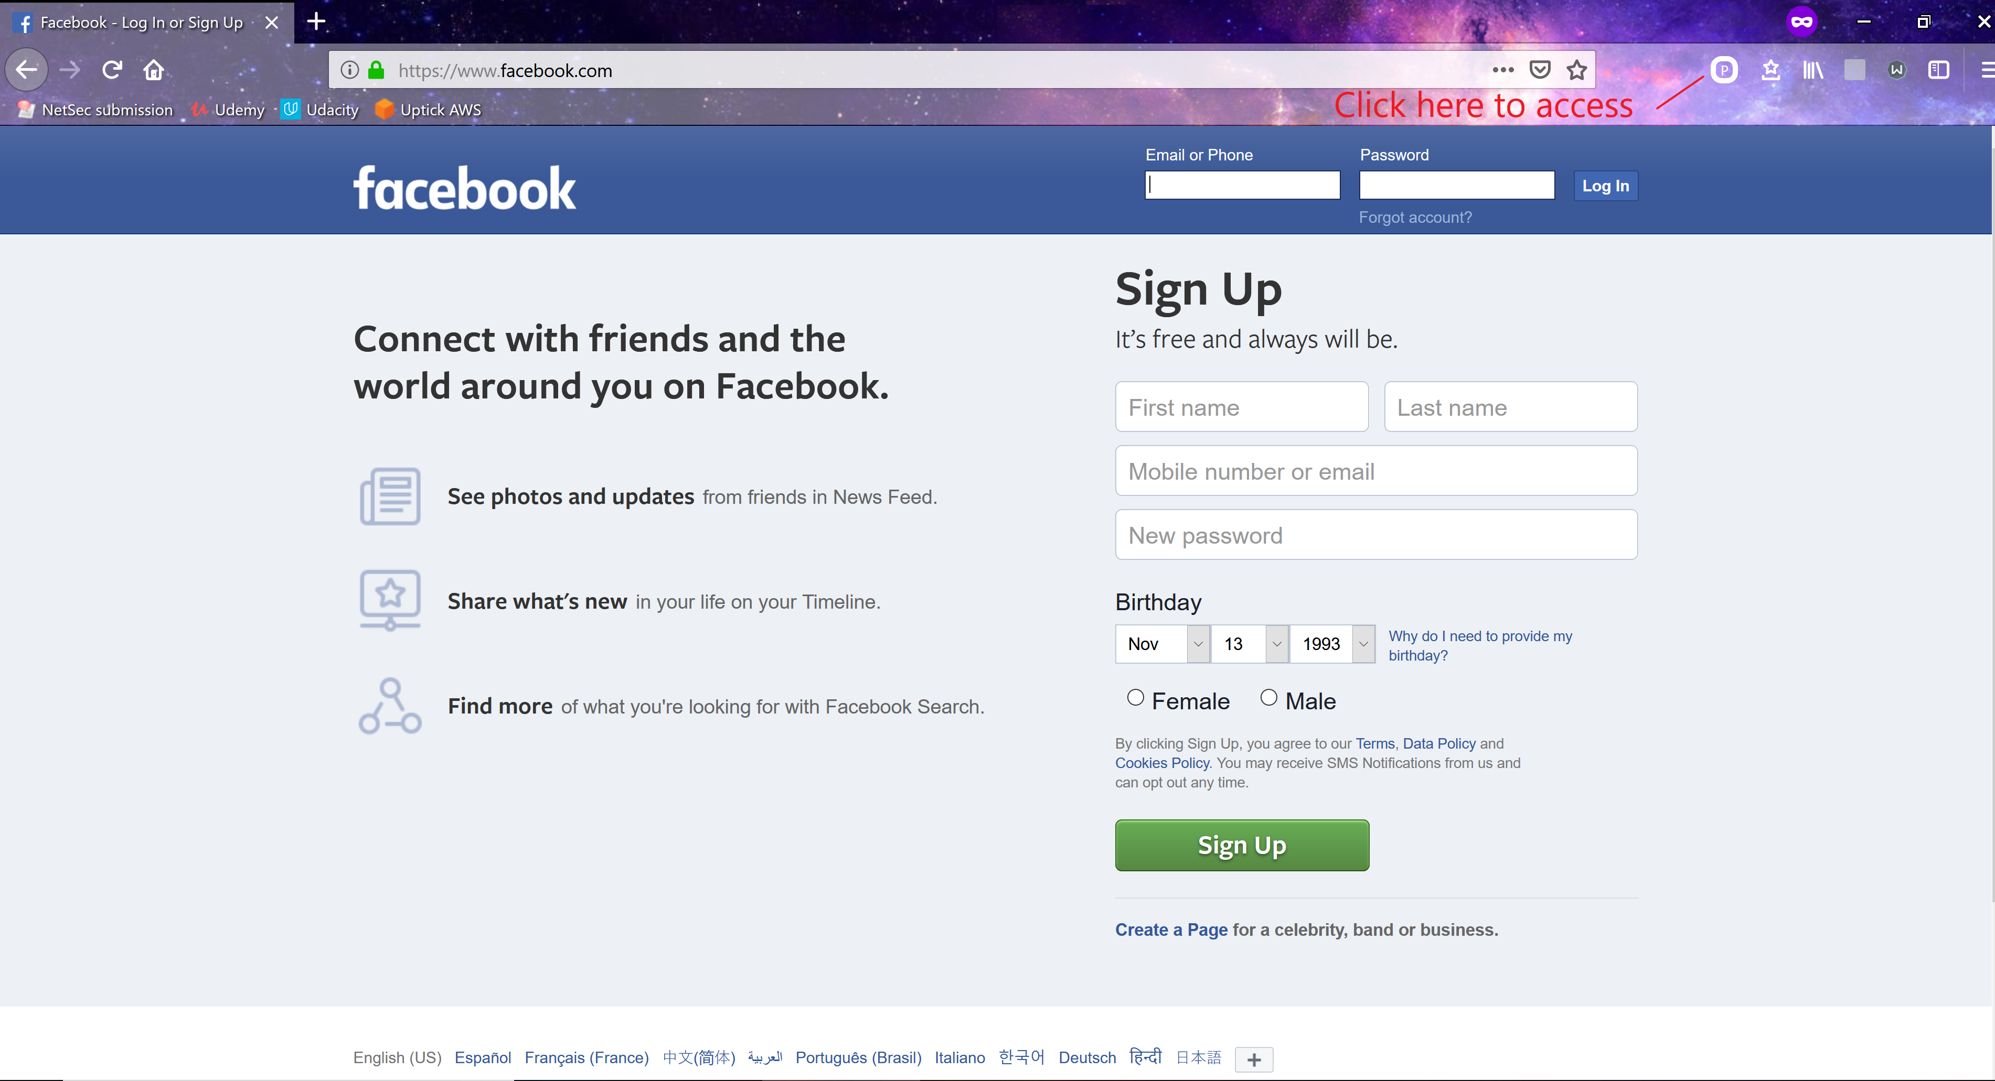

Slide 6
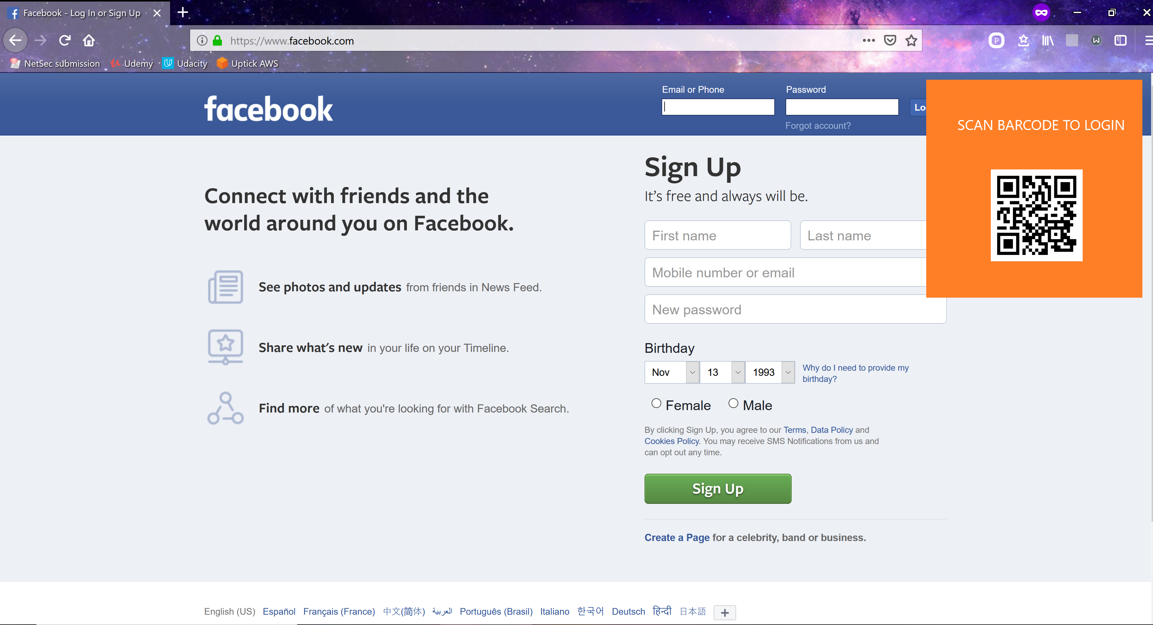

Slide 7
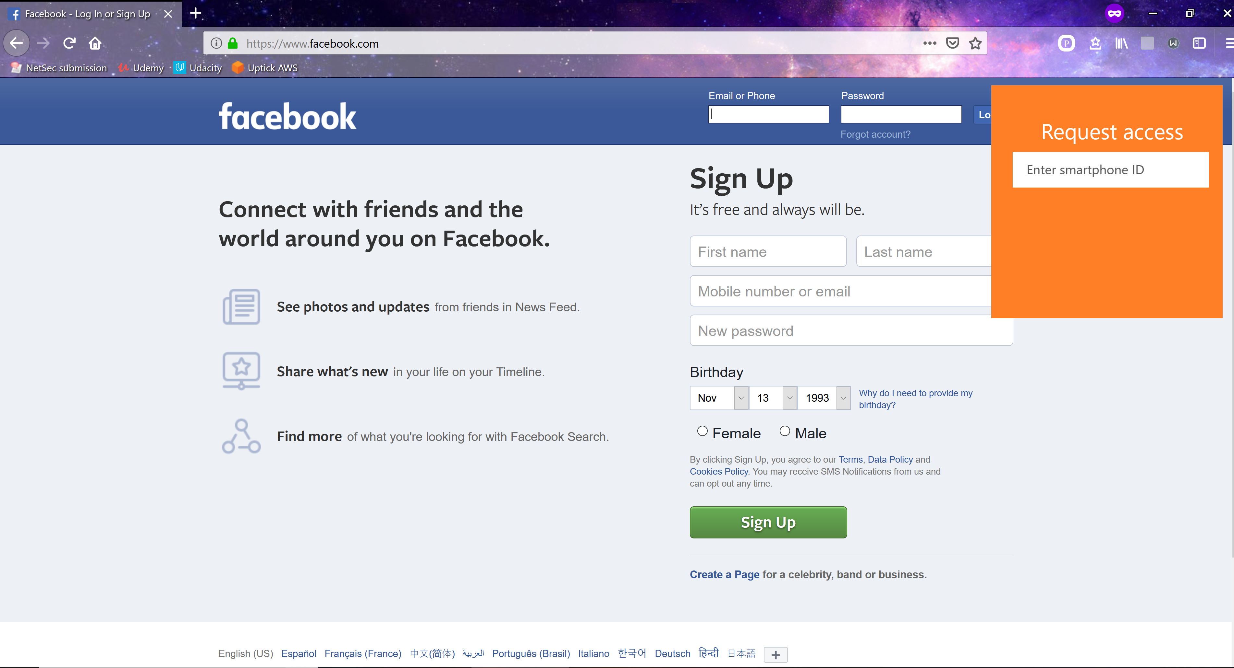

Slide 8
MQTT server (Data transfer)

Slide 9
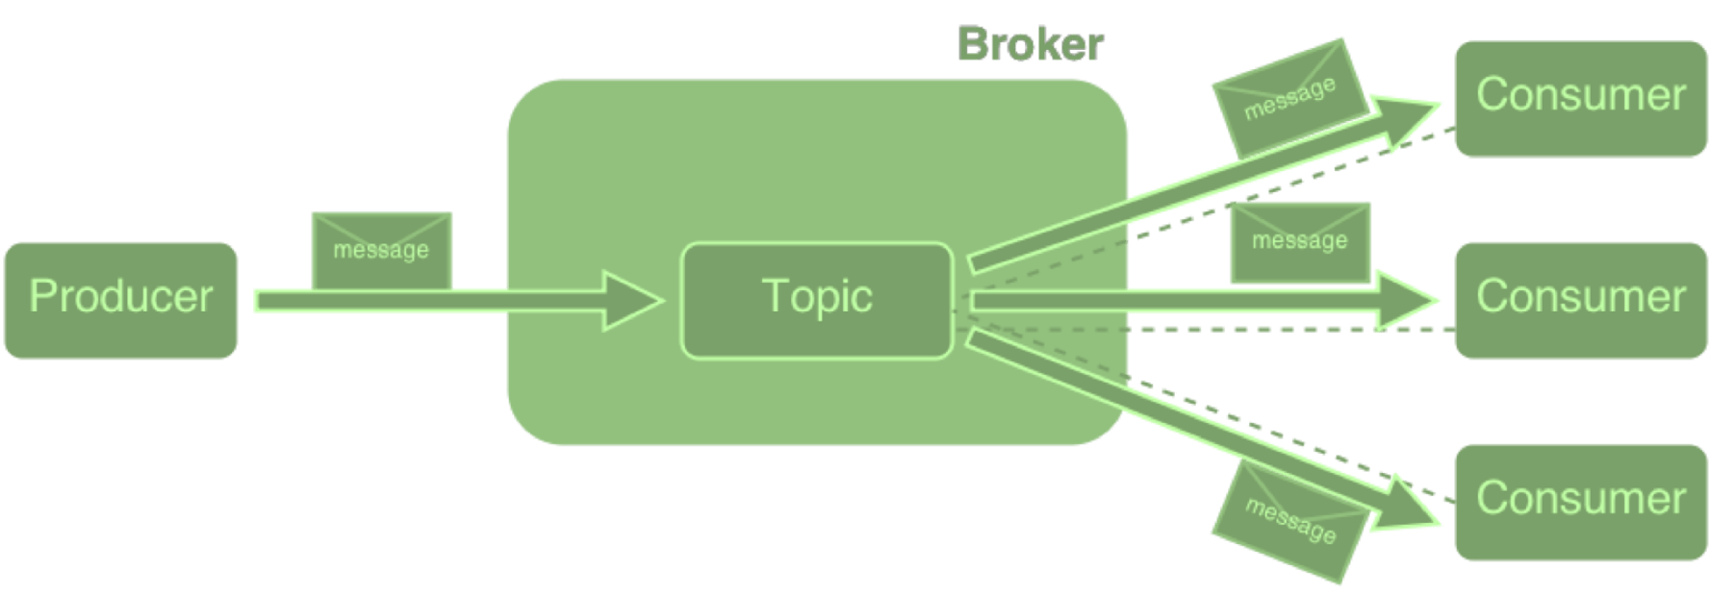
Message Queueing telemetry transport
Publish-Subscribe protocol for P2P
Inbuilt proven support for end to end encryption (TLS)
Light weight clients for all OS in (almost) all languages
All clients identified by unique ID

Slide 10


Connection phone to Firefox
Scan barcode and send discovery message
Request credentials
Response with credentials over TLS
New credentials
The browser keeps sending Heartbeat message to Android from time to time
If Android doesn’t receive heartbeat, or if Firefox doesn’t receive Acknowledgement,
session is reset

Slide 11
Android app

Slide 12
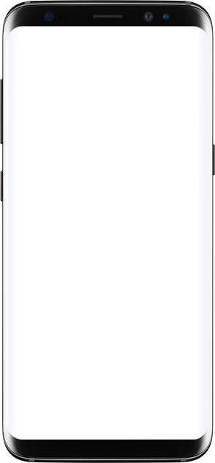

Storing credentials on a different device
1. Use biometrics instead of master passwords
2. Request API type password retrieval allows granular control over
which device can access what credentials
3. Portable – Login to ANY device without ever entering passwords
(No need to remember any password, No eavesdropping,
No keystrokes logging possible)
4. Samsung Knox – Uses 256 bit AES to encrypt all data,
Data is stored in isolated ‘containers’ secured by Biometrics

Slide 13
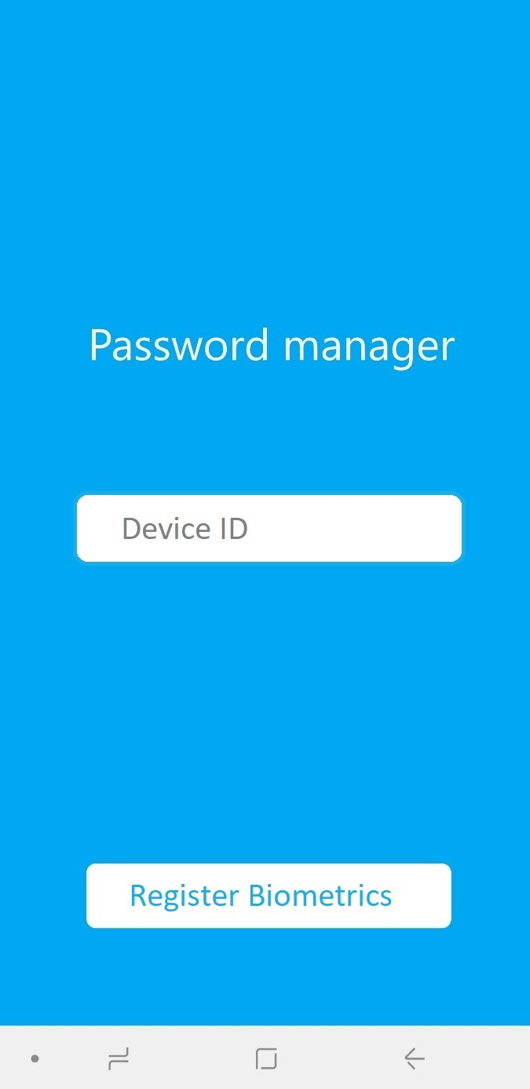


Android storage
MQTT ID
Facebook
Google
Linkedin
Register Biometrics
Key for secure container
Secure container

Slide 14
DRK (Device Root Key) – Assymetric key signed by Samsung using X.509 certificate
DRK is accessible only to privileged software in ‘Trust secure zone’
Basis of the ‘Hardware Root of Trust’
Use this key for AES 256 encryption

Slide 15
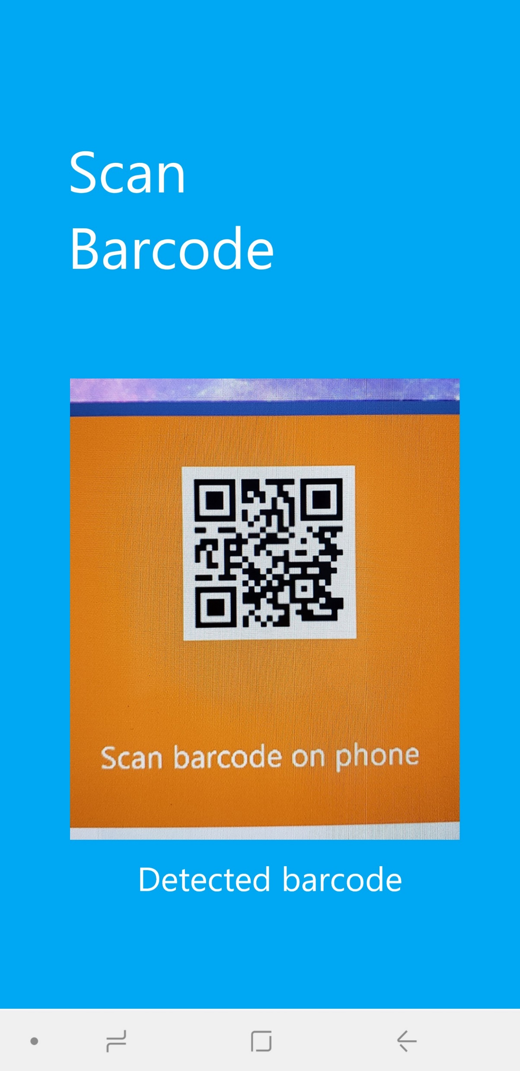
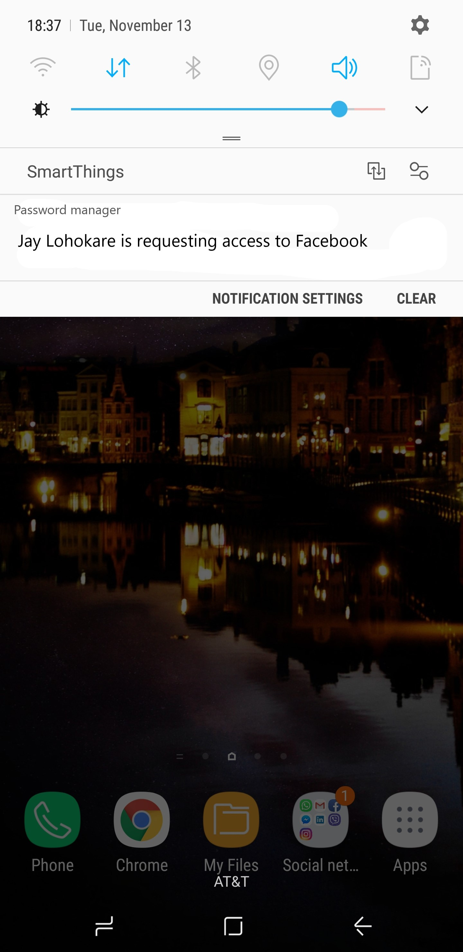
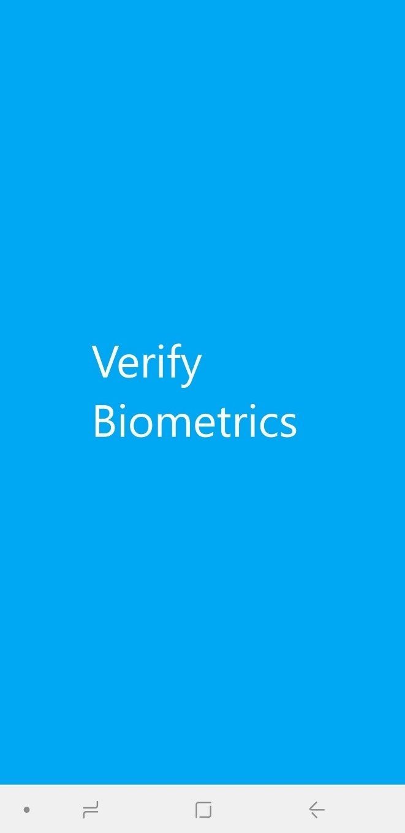

Slide 16
Thank you!

